Slide 1
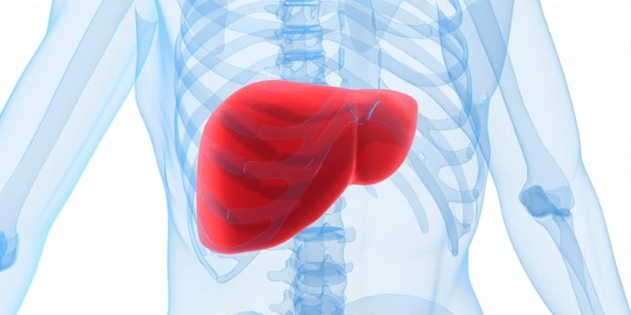
A Classification Project (P444)
Liver Disease Predict
By
Mallika B A
Mekala Jyoshna
Meghana S K
M Prasanna Jahnavi
Premnikhil dudam
Ranpara Priyanka
Sathya Narayanan M

Slide 2
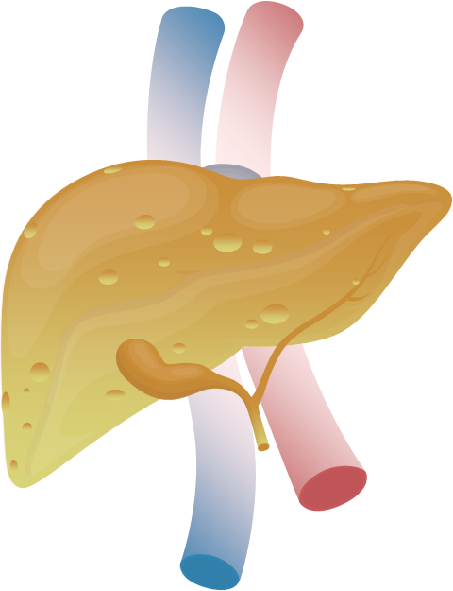
Abstract
This project aims to develop a classification model to predict liver disease status using clinical data, such as enzyme levels and biochemical parameters.
The categories include no disease, suspect disease, hepatitis C, fibrosis, and cirrhosis. Using machine learning techniques, the model identifies patterns in features like bilirubin, albumin, and liver enzymes. The objective is to support early detection and accurate diagnosis, facilitating timely intervention.

Slide 3

Introduction
Liver diseases pose significant health challenges globally, with early detection being crucial for effective management. This project focuses on predicting liver conditions by analyzing patient data, including demographic information and biochemical markers.
The classification covers multiple disease stages to provide detailed predictions, enhancing diagnostic precision. The model will be deployed using Streamlit, offering a user-friendly interface for medical professionals and stakeholders

Slide 4
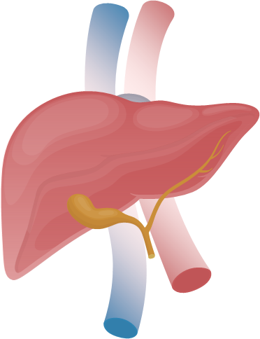
Objectives
The variable to be predicted is categorical (no disease, suspect disease, hepatitis c, fibrosis, cirrhosis). Therefore, this is a classification project.
A brief look at what
we will discuss on this report.
01
Import Libraries
02
Exploratory Data Analysis
03
Visualization
04
Model Building
05
Model Evaluation
06
Deployment

Slide 5

Objectives in Detail
1
Import Libraries
4
Model Building
For Libraries required for data manipulation, visualization, model building and evaluation.
Libraries like pandas, numpy, seaborn, and sklearn are commonly used.
Select a machine algorithm and training the models. Examples are
Logistic Regression
Random Forest
Decision Trees.
2
Exploratory Data Analysis
5
Model Evaluation
EDA helps summarize and understand the dataset main characteristics. Such as
Distributions,
Missing values,
Relationships between variables.
Model evaluation measures performance using metrics like accuracy, precision, recall, and confusion matrices. It helps determine how well the model generalizes to new, unseen data.
Visualization
Deployment
3
6
Visualization involves creating charts like histograms, scatter plots, and heatmaps to uncover patterns and relationships in the data. It provides visual insights that inform decision-making during model building.
Deployment makes the model accessible to users by integrating it into applications via APIs or web apps. Tools like Streamlit, Flask, or FastAPI are often used for serving the model.

Slide 6
1. Libraries
( Which we have used in the whole project )
import pandas as pd
import numpy as np
import matplotlib.pyplot as plt
import seaborn as sns
import warnings
warnings.filterwarnings('ignore')
from sklearn.preprocessing import LabelEncoder
from sklearn.preprocessing import StandardScaler
from sklearn.model_selection import train_test_split
from sklearn.metrics import Classification_report, accuracy_score, confusion_matrix
from sklearn.ensemble import RandomForestClassifier
from sklearn.linear_model import LogisticRegression
from sklearn.svm import svc
from sklearn.neighbors import KNeighborsClassifier
from sklearn.neural_network import MLPClassifier
from sklearn.model_selection import GridsearchCV
from sklearn.ensemble import VotingClassifier
Import joblib

Slide 7
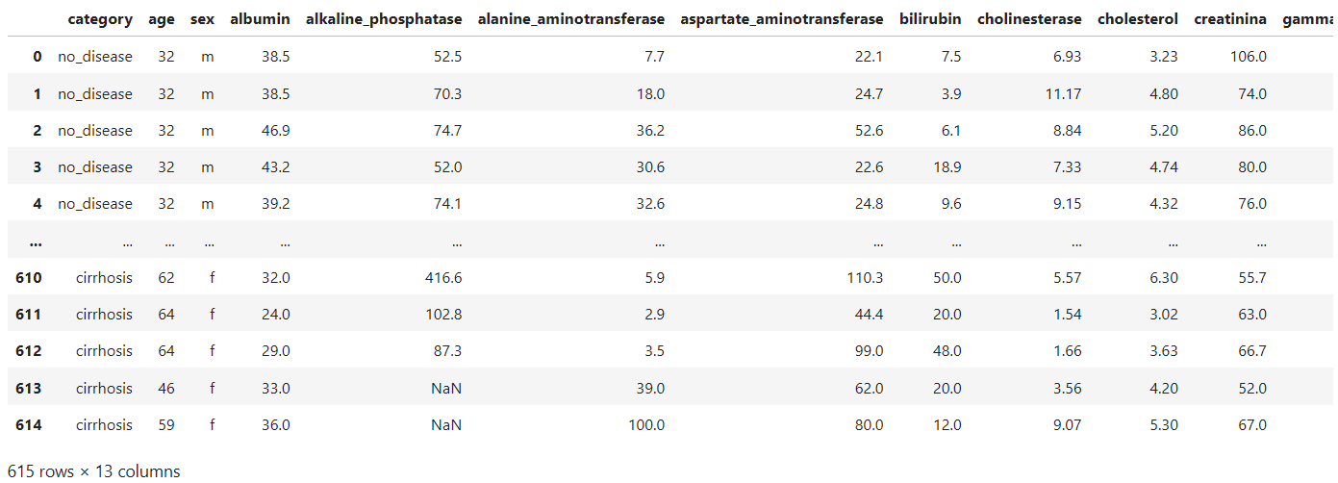
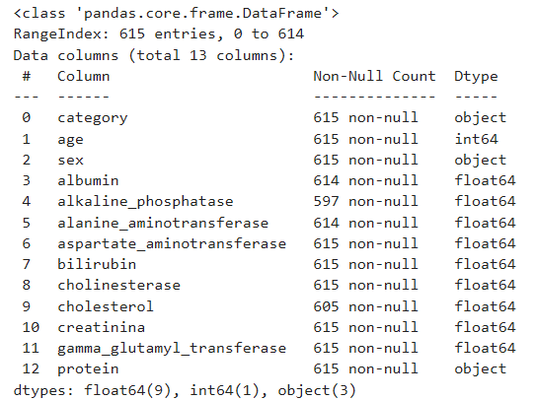
Understanding The Data Set
Display basic information about the dataset
The liver disease classification dataset contains 615 instances (rows) and 13 variables (columns), which capture critical clinical information from patient records. The dataset primarily consists of numeric values derived from various blood and urine analysis tests, with the exception of one binary feature, Sex (male or female). These variables represent key health indicators that are essential for diagnosing liver conditions.

Slide 8

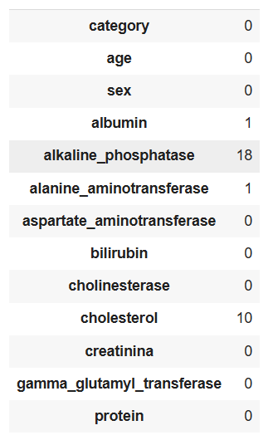
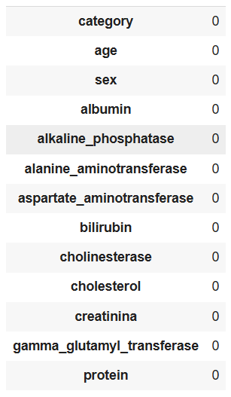
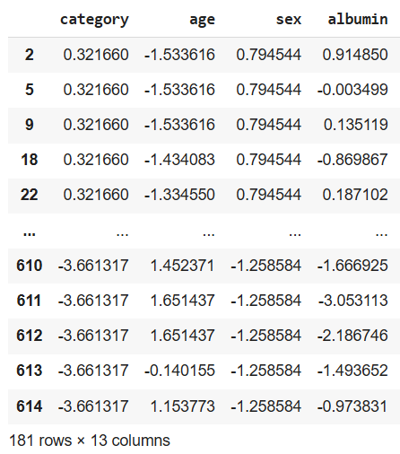
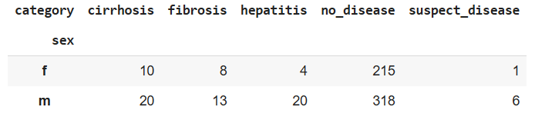
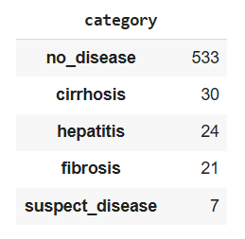
2. Exploratory Data Analysis
Data Preprocessing
Missing Data
Missing Data in the Dataset was imputed using the median for numerical values, ensuring that model could train on complete data
Outliers
IQR(Interquartile Range) method to remove extreme values for model stability
Encoding
The binary categorical variable, Sex, and the target variable, category (liver disease class), were encoded into numerical values using LabelEncoder, allowing the machine learning model to process categorical data.

Slide 9
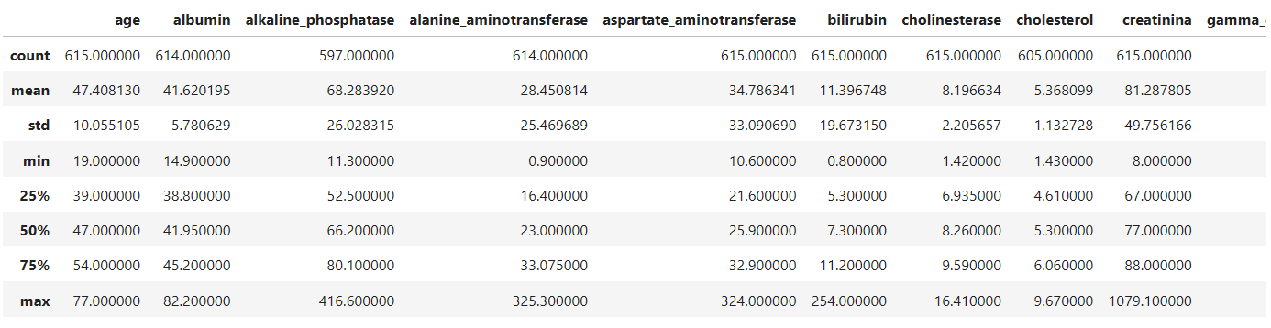
This table provides summary statistics (like count, mean, standard deviation, min, and max) for various medical attributes used in liver disease analysis, such as age, albumin, and bilirubin. It helps understand the data distribution and variability for each feature.

Slide 10
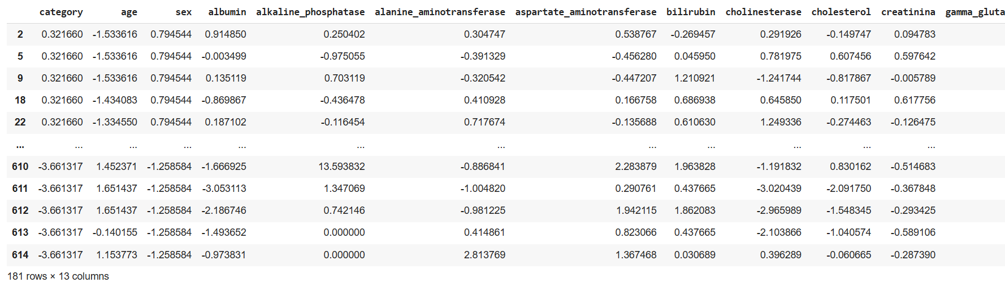
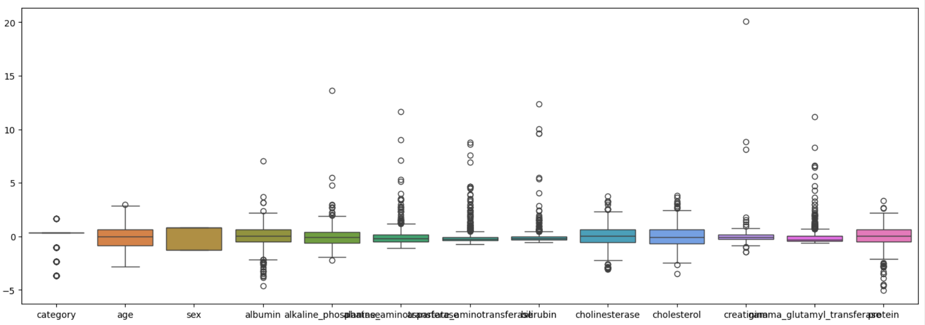
Outlier
The top table shows normalized data across 13 medical features for liver disease prediction. The box plot below visualizes the distribution and spread of these features, highlighting outliers and variability.

Slide 11
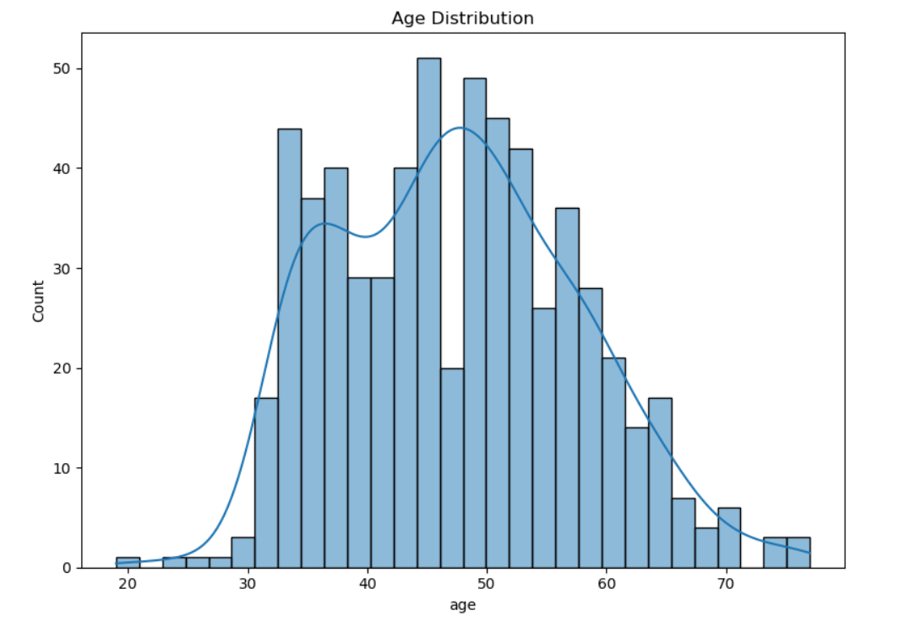
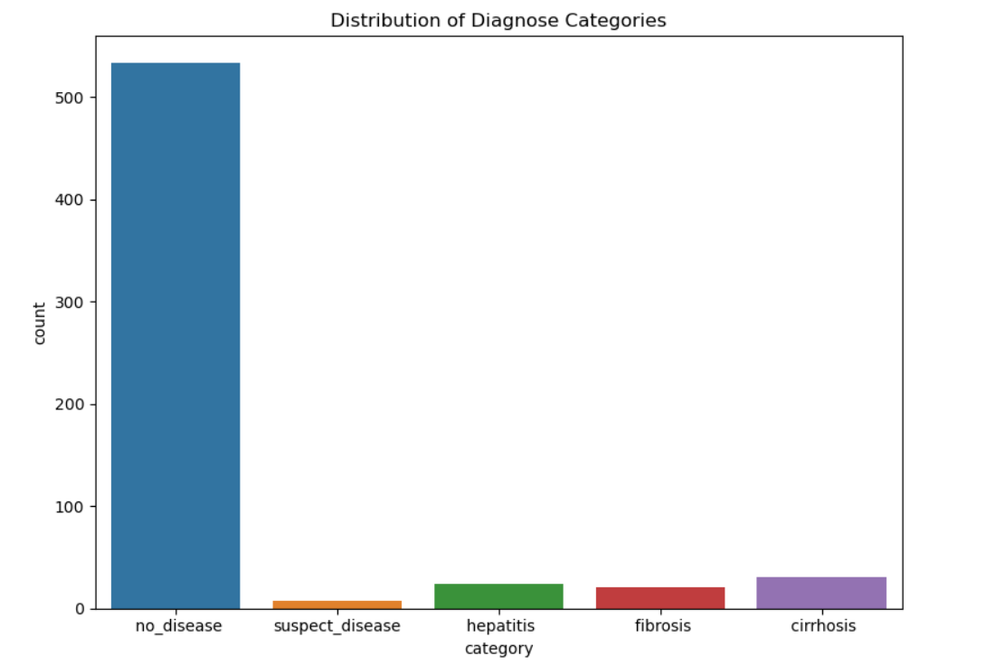
3. Visualization
Histogram Plot
(Distribution of Age)
The histogram shows the distribution of age in the dataset, with most individuals falling between 35 and 55 years. The curve overlay suggests a roughly normal distribution with a slight skew towards older ages.
Count Plot
(Distribution of Categories)
The count plot shows that the 'no_disease' category has the highest frequency, significantly outnumbering the other diagnosis categories. Categories like 'suspect_disease,' 'hepatitis,' 'fibrosis,' and 'cirrhosis' have much lower counts, indicating a class imbalance.

Slide 12
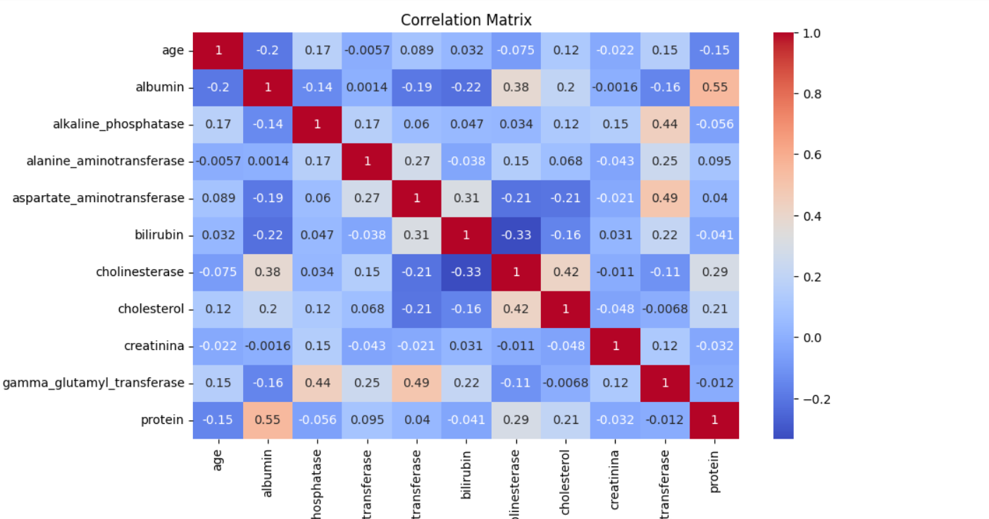
Correlation Analysis
The correlation matrix visualizes the relationships between various medical features, showing both positive (red) and negative (blue) correlations. Strong correlations are observed between some pairs, like 'albumin' and 'protein' (0.55) or 'bilirubin' and 'aspartate_aminotransferase' (0.31), while most variables have weak or no significant correlations.

Slide 13
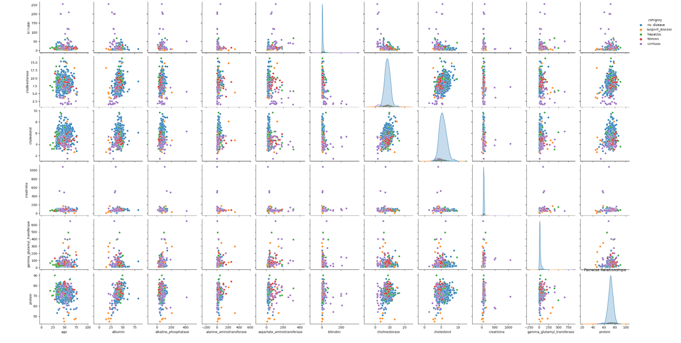
Pair Plot
The pair plot displays scatter plots for all feature pairs, highlighting relationships between variables for different diagnostic categories. The diagonal shows the distribution of each feature, with color coding used to distinguish between the various diagnostic categories.

Slide 14
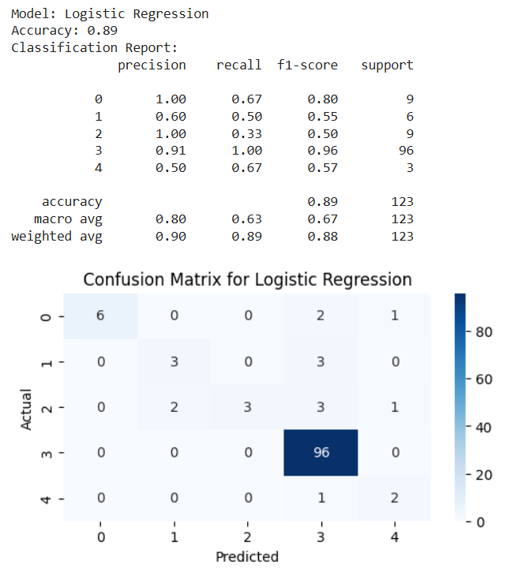
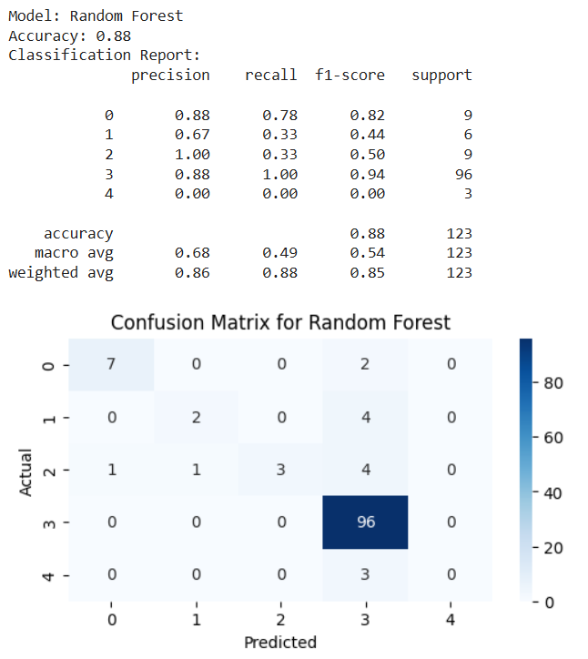
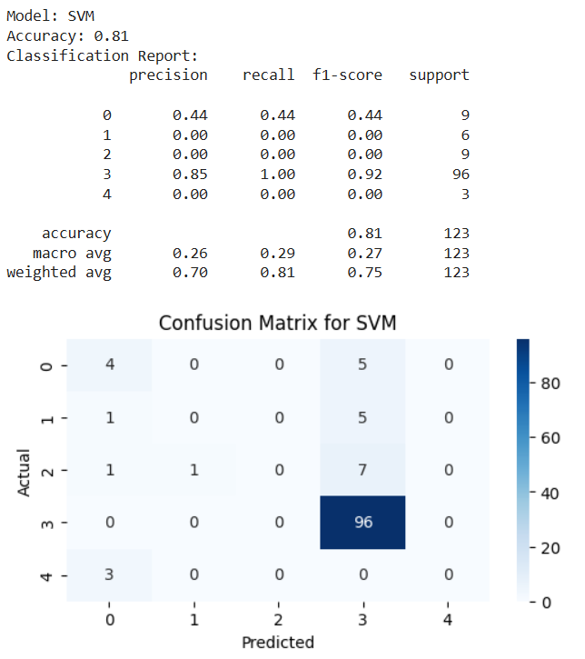
4. Model Building & Evaluation
Model building refers to the process of selecting and training machine learning algorithms on a dataset to create a predictive model.
Model evaluation involves assessing the model's performance using metrics like accuracy, precision, recall, and F1-score to ensure it generalizes well to unseen data.
The goal is to choose the best-performing model and tune it for optimal results
Logistic Regression
Random Forest
Support Vector Machines

Slide 15
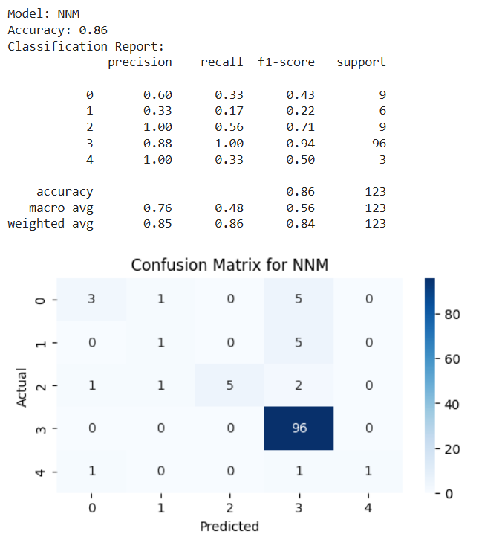
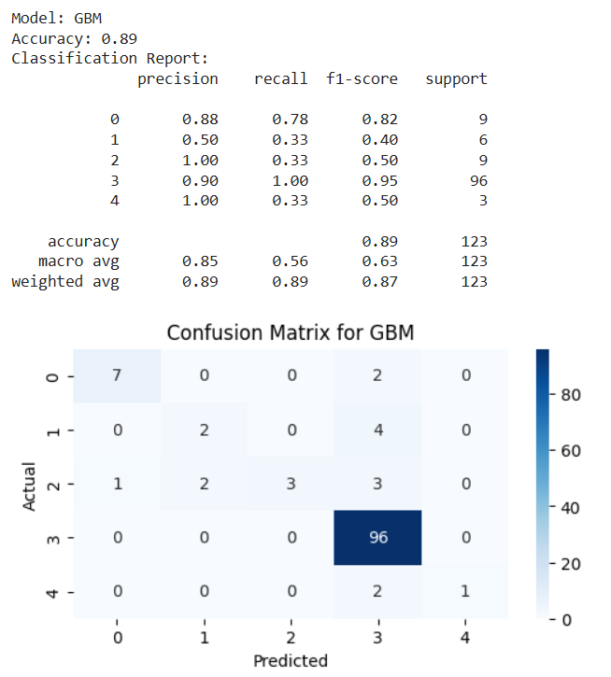
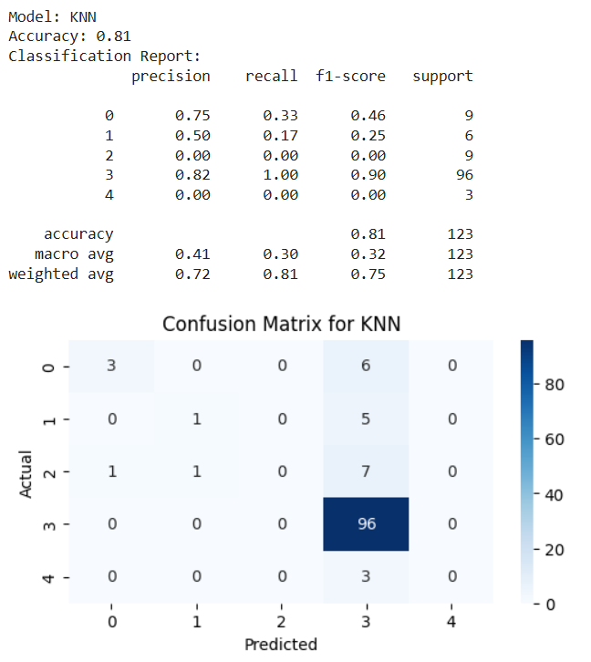
The image compares the performance of three models: Logistic Regression, Random Forest, and SVM. Logistic Regression has the highest accuracy (0.89), Random Forest is close (0.88), while SVM lags behind (0.81), with Logistic Regression and Random Forest also showing better recall and F1-scores across most classes.
The image compares the performance of KNN, GBM, and NNM models. GBM shows the best accuracy (0.89), followed by NNM (0.86), while KNN has the lowest (0.81), with GBM also performing better across precision, recall, and F1-score metrics.

Slide 16
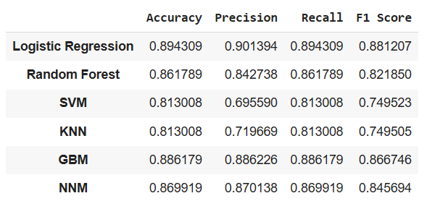
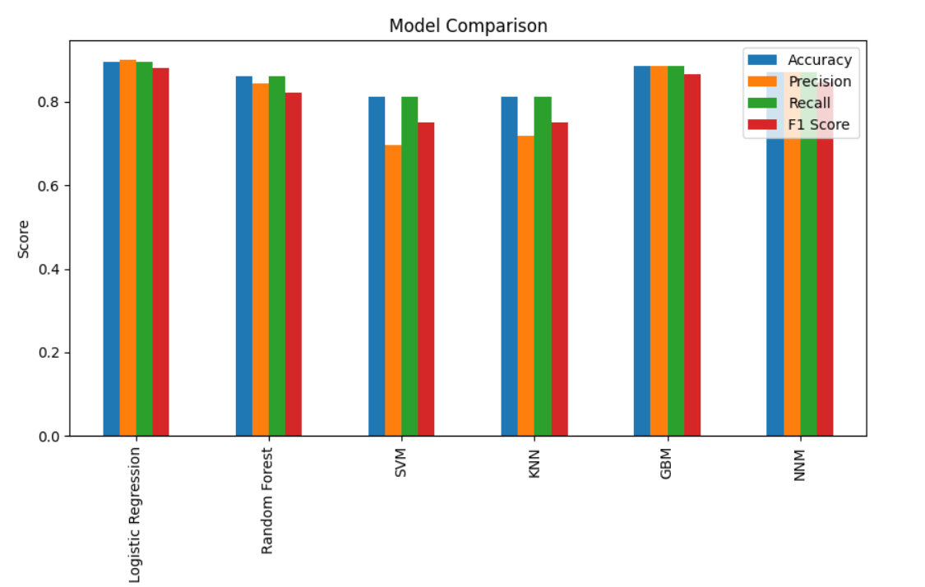
Compare Model’s Performance
The table and bar chart compare multiple models based on accuracy, precision, recall, and F1 score. Logistic Regression performs the best overall, followed by GBM and Random Forest, while SVM and KNN show lower performance across all metrics.

Slide 17
6. Deployment
After successful evaluation, the trained model was saved using Joblib, making it ready for deployment in real-world healthcare settings where it can assist in the diagnosis of liver disease.
"This web application predicts liver disease categories based on user inputs such as age, sex, albumin levels, and other health-related metrics.“
Model and Libraries:
Stream lit: Used for building an interactive web app interface.
Job lib: Loads the pre-trained model (model.pkl).
Num py: Manages input data for model prediction.
Label encoder: Encodes and decodes the prediction labels for interpretation.
User Interface:
Users provide health inputs (age, sex, albumin levels) via interactive widgets.
Input types: number_input for numerical values, selectbox for categorical inputs (sex).
Example: Sex is encoded (0 for Male, 1 for Female) for the model.
Prediction Process:
Input data is transformed and passed to the model. The pre-trained model outputs predictions, which are decoded and displayed to the user.

Slide 18
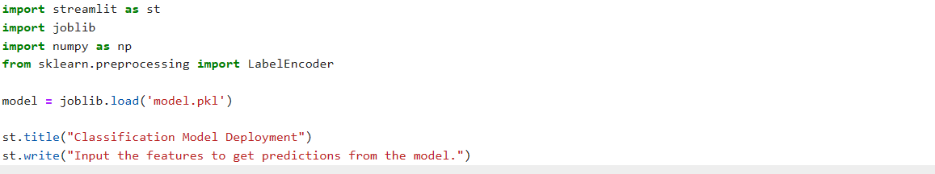
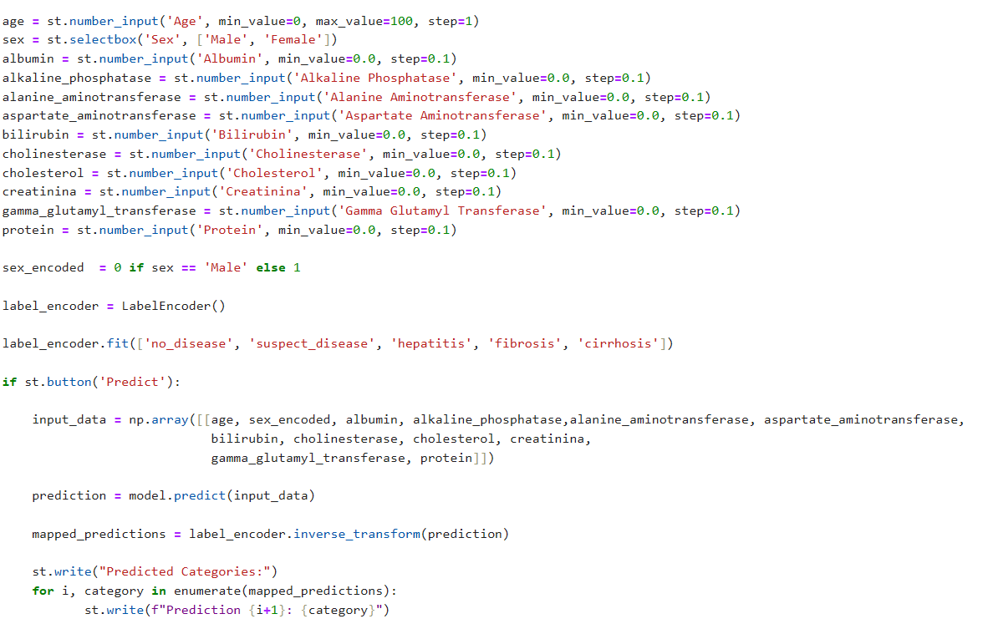
Deployment
Code
The code is a Streamlit-based app for predicting liver disease categories using a pre-trained model. It collects user inputs for various health metrics (e.g., age, sex, albumin levels) via interactive widgets. The "Sex" input is encoded numerically, and the collected data is processed as a NumPy array for prediction. The model outputs a category, which is decoded using LabelEncoder to display the disease type. The prediction results are then shown on the web interface.

Slide 19
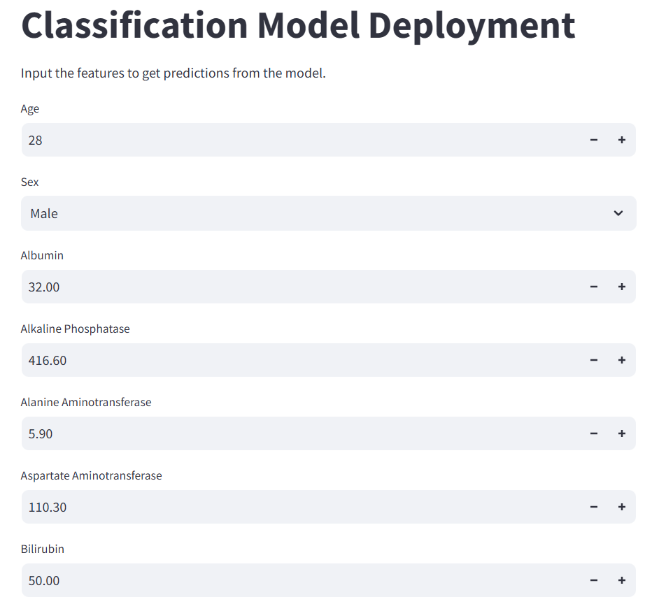
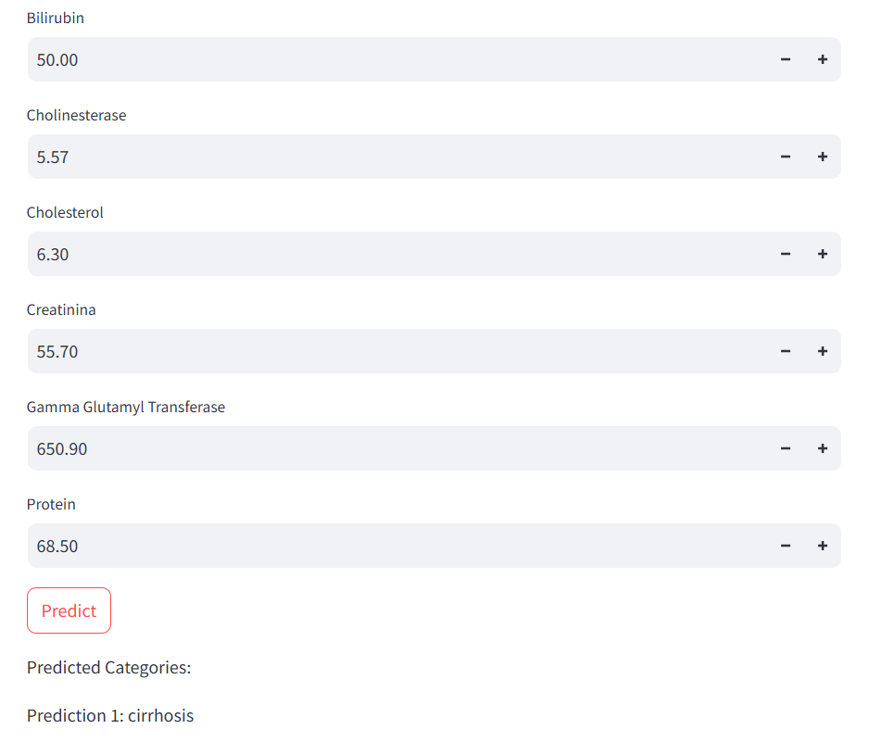
Output

Slide 20
Challenges
Class Imbalance
2. Feature Correlation and Redundancy
3. Missing or Noisy Data
4. Generalization to Unseen Data
5. Interpretability of the Model
6. Deployment and Performance Optimization
Conclusion
Performance Recap: The Logistic Regression model performed best, achieving 90% accuracy with robust predictions across liver disease categories.
Business Impact: Our model can be used as a decision support tool for early detection of liver disease, helping clinicians make better treatment decisions.
Future Work: Suggest future improvements, such as gathering more data or adding more features.

Slide 21
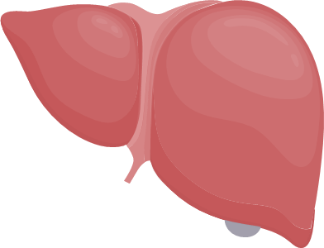
Thank
You
For
Watching

